Slide 1
.NET application modernization and cloud migration
Ben Prejean, Principal Engineer
Chief Technology Office – Application and Cloud Transformation
Wells Fargo Technology
November 2023

Slide 2
.NET challenges
Where we started: January 2020
Scarce adoption of .NET core
Windows Azure pack end-of-life
Technical architects encouraging migration to Java
.NET full framework misaligned with Linux container strategy
Lack of internal .NET community engagement
Continuous Integration/Continuous Delivery (CI/CD) pipeline did not support .NET core
Go-forward private cloud had not enabled .NET core

Slide 3
Product vision
For developers and engineers building new .NET core applications or migrating .NET full framework applications to cross-platform .NET core applications, the Wells Fargo .NET Core Enablement and Migration Toolkit is a collection of guidance, best practices, tools, and automation that will drastically reduce development time, effort, and complexity.

Slide 4
Business objectives
Support cross-platform/cloud platform agnostic strategy
Increase migration efficiency to meet Windows Azure pack (WAP) end-of-support timeframe
Automate manual tasks to improve efficiency
Improve consistency across migrations and new development
Empower and educate engineers in .NET core
Support establishment of .NET core hosting environments and Software Development Lifecycle (SDLC) processes

Slide 5
Product roadmap
 | Cross-platform Cloud agnostic | Increase migration efficiency | Automate manual tasks | Improve consistency | Empower and educate | Support hosting environments
Document General .NET Core Migration Guidance | ✓ | ✓ |  | ✓ | ✓ | ✓
Build Automation supporting .NET Core Migration |  | ✓ | ✓ | ✓
Create .NET Core Migration Inner Source Code Samples |  | ✓ | ✓ |  | ✓
Document 3rd Party Dependencies with .NET Core Support |  | ✓ |  | ✓
Identify and Prove out Alternatives to 3rd Party Dependencies which do not Support .NET Core |  | ✓ |  | ✓ | ✓
Utilize and Document Existing .NET Core Migration Tools | ✓ | ✓ | ✓ | ✓
Document ASP.NET Core Migration Guidance | ✓ | ✓ |  | ✓ | ✓
Support .NET Core utilization of the Enterprise Pipeline |  | ✓ | ✓ | ✓
Identify Processes and Tools for Ensuring Cross Platform Support | ✓
Support .NET Core Environment Establishment and Availability on Wells Fargo Supported Hosting Environments as well as required Core Services | ✓ |  |  |  |  | ✓

Slide 6
Engagement model
The way the .NET core enablement and migration team delivers value to our customers is based on these tenets:
We empower migrations and new development
Application teams are responsible for migrations and new development
Automated processes over manual interventions
Self-service guidance over hand-delivered information
Collaboration is bi-directional

Slide 7

Guidance details
The .NET core enablement and migration guidance is published in a Confluence space.
The goal of our guidance is to provide timely and relevant details that will empower and increase the efficiency of developers in their .NET core work.
Utilizing new .NET core tools
.NET core automation tools
Example: Visual Studio Code and the .NET Core CLI.
Example: Migration jumpstart automation
Cloud platforms provisioning
Migration samples
Example: Interacting with and onboarding to supported cloud platform – PCF / TAS
Example: How to manage environment specific configuration in .NET core adhering to the 12 Factor Configuration Principle
General .NET core migration
Enterprise Pipeline
Example: Overall high-level migration process
Detailing .NET core-specific aspects of the Enterprise Pipeline

Slide 8

Automation tools
Migration readiness scan
Consists of NuGet package and portability analyzer scans
Identifies the NuGet packages and .NET full framework types that don’t support .NET core, and offers guidance on the same
Shows visibility across the portfolio of the most utilized packages or types that don’t support .NET core
Greenfield jumpstart automation
Create new .NET core solutions and projects based on Wells Fargo templates and required components
Migration jumpstart automation
Creates new .NET core solutions and projects based on existing .NET full framework solutions and projects
Automates many tasks that would require manual effort, such as generating .NET core configuration settings, updating NuGet packages, and project references
Generates a to-do list of actions that must still be taken as part of the migration
Automate based on additional learnings
Continually identify and automate additional tasks to increase efficiency and consistency
Config-Gen (Configuration Generation Tool)
EPL (Enterprise Pipeline Configuration Tool)
Dep-scan (Dependency Scanning Tool)

Slide 9
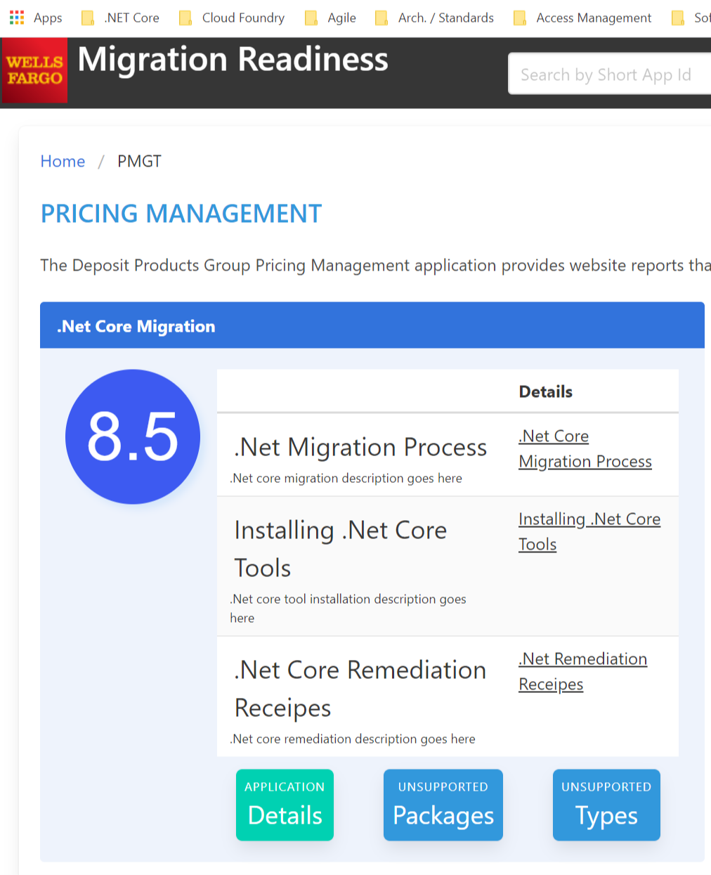
Automation tools

Slide 10




Learning approach
Learning sessions
Topic-specific pop-up sessions
Open office hours
Tutorial videos
Targeted self-paced videos
External training
Curated training content from Pluralsight, Channel 9, and other learning tracks
Learning through code
Code samples in our Inner Source Enterprise GitHub repository
Collaborative pull requests and feature requests

Slide 11
Business outcomes
Where we are today: November 2023
.NET 6/7 is now a first-class option alongside Java
.NET 6/7 is fully supported in our on-premise Linux-based private clouds
Hundreds of Windows Azure Pack applications have migrated or are in the process of migrating to .NET core
First-ever .NET inner source sample and tool repositories with more artifacts and participation than Java
Over 1,000 .NET engineers are trained in .NET core
.NET 6/7 is a key part of our companywide application migration/greenfield application strategy in public cloud

Slide 12
Thank you

